Slide 1
Fishing Game
Jing Wang (Jane) CS 5001 final project

Slide 2





Fishing Game-What is it
The game is based on timed mode and the task is to hook the most fishes in 30 seconds.
Getting fishes will give the player bonus time, cost more or die immediately.
Arrow key “left”
Arrow key “right”
Arrow key “down”
30s
Die
+ 10s
+ 1s
-10s
Notes:
When the hook touch the fish, the fish will be hooked up and placed in the boat.

Slide 3
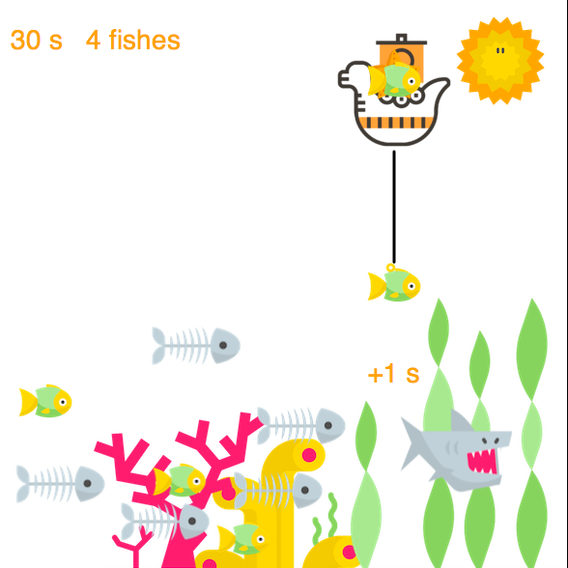
Fishing Game-Big Bang
Fishing world
(struct fishing-world
(boat hook fishes goals bonus counter speedup)
Boat (struct boat (posn)
Hook (struct hook (down? up? posn)
Fish (struct fish (image speed posn)
Fishes/goals list of fish, swimming or catched
Bonus display current bonus (struct bonus (number posn fade)
Counter/speedup Variable, timer for counting down 30s, increment of fish speed(1/s)
counter
Length of goals
boat
hook
bonus

Slide 4
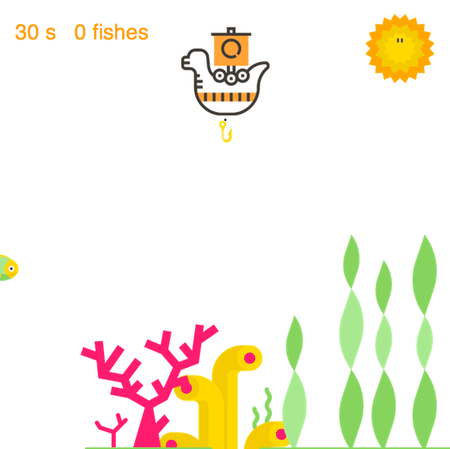
Fishing Game Big Bang-initialize
(define (go-fishing)
(big-bang (initialize-fishing-world)
(on-tick fish-swimming TICK-RATE)
(on-key direct-and-hook-fish)
(to-draw render-fishing)
(stop-when end-of-fishing? game-over-text)))
(fishing-world
boat hook fishes goals bonus counter speedup)

Slide 5
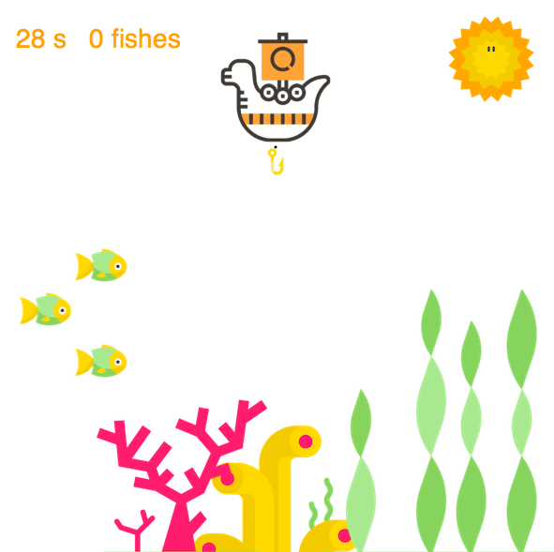
Fishing Game- Big Bang on-tick
(define (go-fishing)
(big-bang (initialize-fishing-world)
(on-tick fish-swimming TICK-RATE)
(on-key direct-and-hook-fish)
(to-draw render-fishing)
(stop-when end-of-fishing? game-over-text)))
Speedup
Initial(30s)
x
28s
X+2
FISH
X+1
29s
(fishing-world
boat hook fishes goals bonus counter speedup)

Slide 6
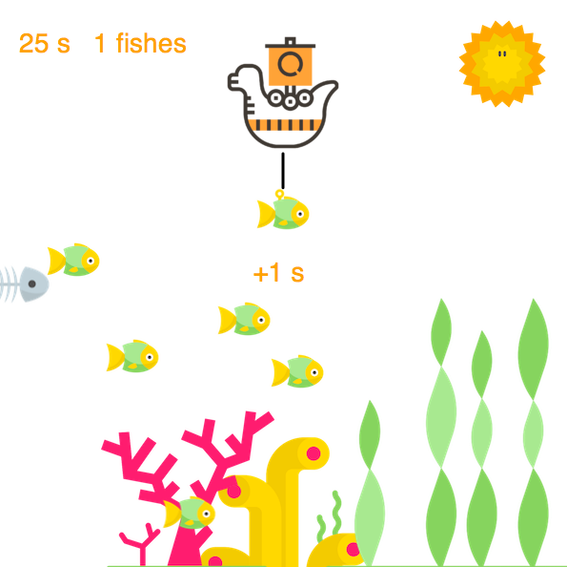
Fishing Game- Big Bang on-tick
+1S
+1
HOOK
(define (go-fishing)
(big-bang (initialize-fishing-world)
(on-tick fish-swimming TICK-RATE)
(on-key direct-and-hook-fish)
(to-draw render-fishing)
(stop-when end-of-fishing? game-over-text)))
GOA L
FISH
(fishing-world
boat hook fishes goals bonus counter speedup)

Slide 7
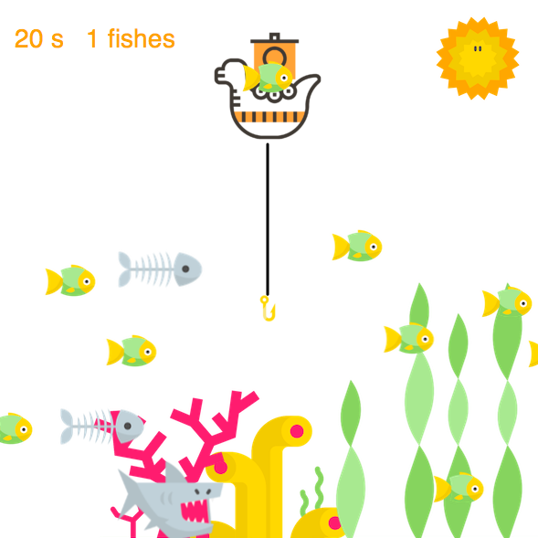
Fishing Game Big Bang on-key
(define (go-fishing)
(big-bang (initialize-fishing-world)
(on-tick fish-swimming TICK-RATE)
(on-key direct-and-hook-fish)
(to-draw render-fishing)
(stop-when end-of-fishing? game-over-text)))
space
pause
(fishing-world
boat hook fishes goals bonus counter speedup)

Slide 8
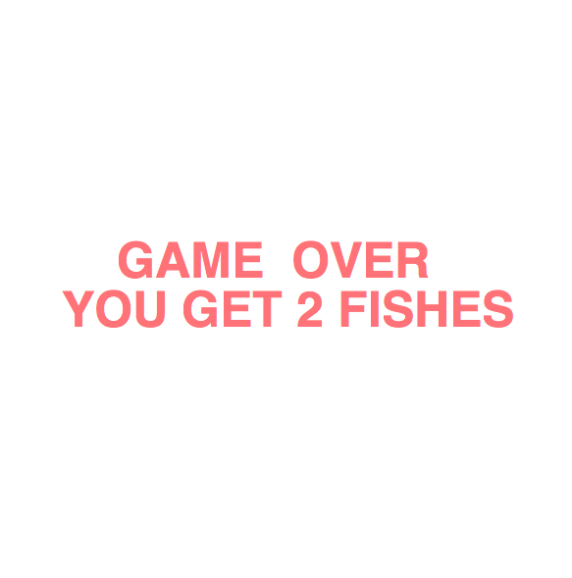
Fishing Game Big Bang stop-when
(define (go-fishing)
(big-bang (initialize-fishing-world)
(on-tick fish-swimming TICK-RATE)
(on-key direct-and-hook-fish)
(to-draw render-fishing)
(stop-when end-of-fishing? game-over-text)))
0s

Slide 9
Fishing Game-Music(gui/rsound)
Play game sound
(require (racket/gui))
(play-sound sound #t))
Play background music
(require rsound)
This collection provides a means to represent, read, write, play, and manipulate sounds.
(define BACK-MU (rs-read "graphics/SEA.wav"))
(make-pstream)/(pstream-queue pstream sound current-p)
Create a new pstream and start playing it.
Game end
HAPPY
SAD

Slide 10
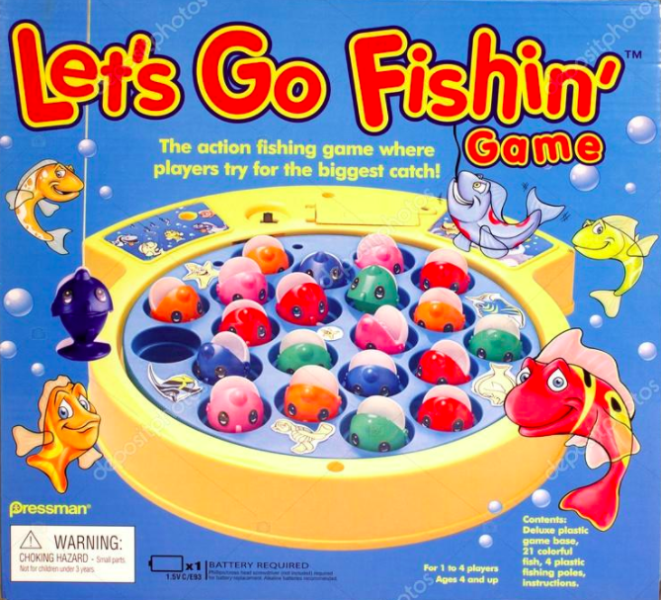
Fishing program-reason to design
Want to use big bang to create a game
Used to play when I was young
how to let every element in the game act differently at the same time.

Slide 11
Demonstration
Jing Wang (Jane) CS 5001 final project

Slide 12
Thank you!
Jing Wang (Jane) CS 5001 final project

